Slide 1
The Gravitational Many Body Problem
John Bower
Computational Physics
05/05/2016

Slide 2
Outline
Why pursue this at all?
How to pursue this?
Testing veracity
Results
Future

Slide 3
Motivation
No general analytical solution
Only special cases or approximations
A problem as old as calculus
(A tale as old as time?)

Slide 4
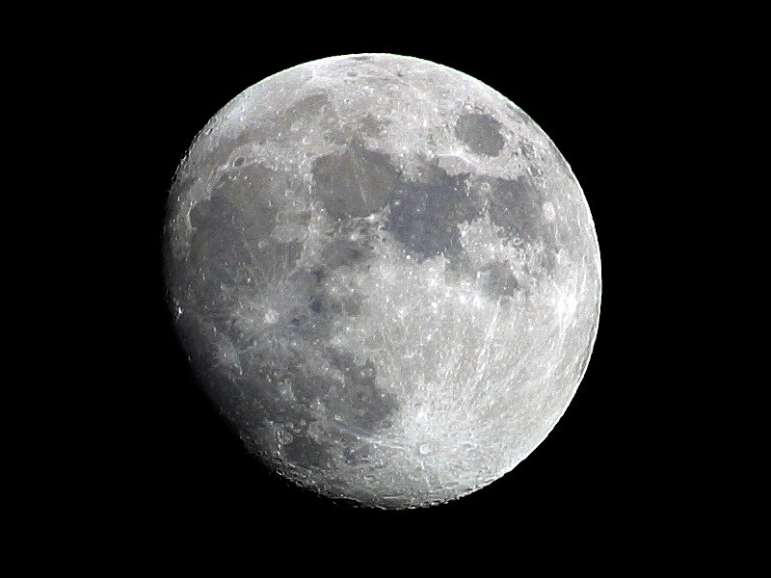

Slide 5
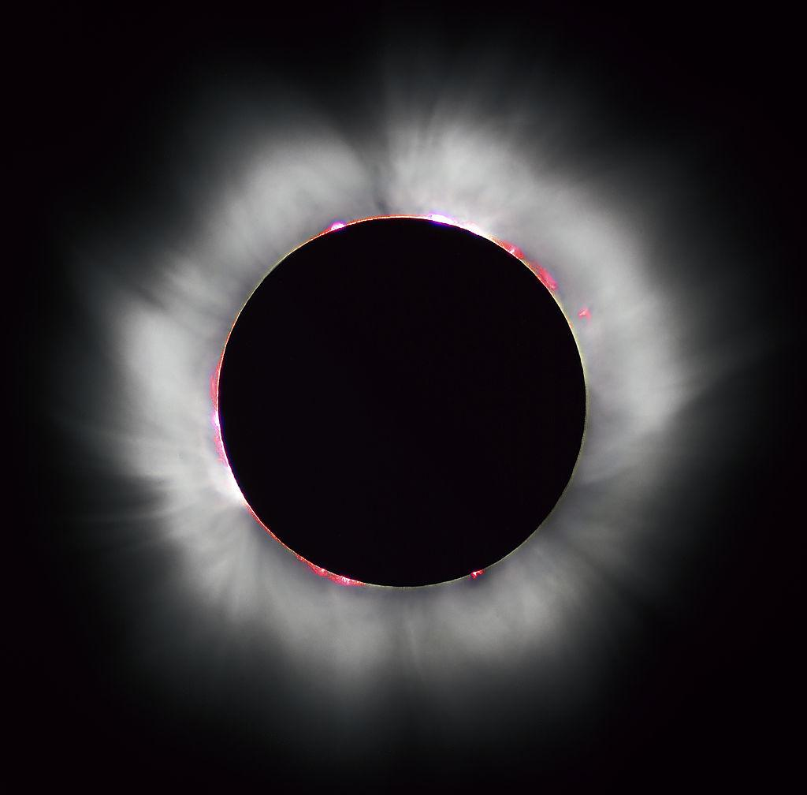

Slide 6
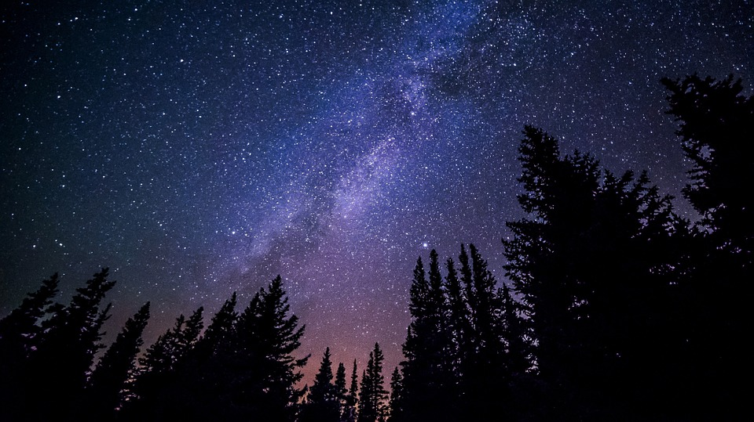

Slide 7
Development
Two Methodologies:
Verlet
Runge-Kutta (4)
Make use of:
Taylor Expansions
Fundamental Theorem of Calculus
Simpson’s Rule

Slide 8
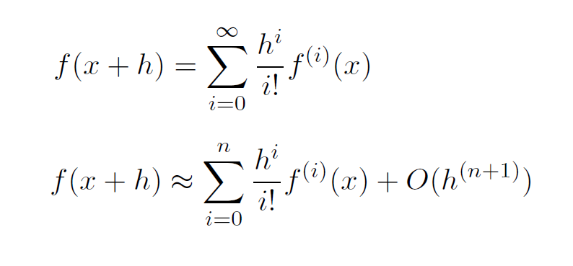
Development
Taylor Expansion

Slide 9
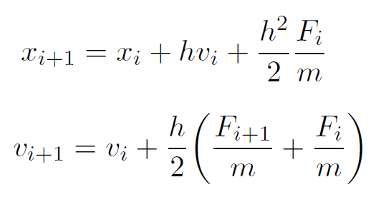
Development
Verlet

Slide 10
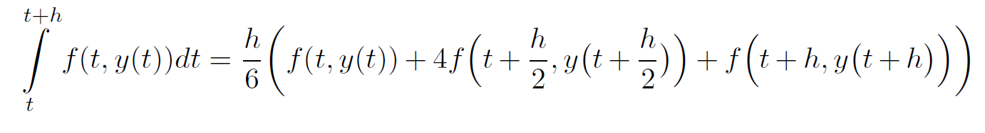
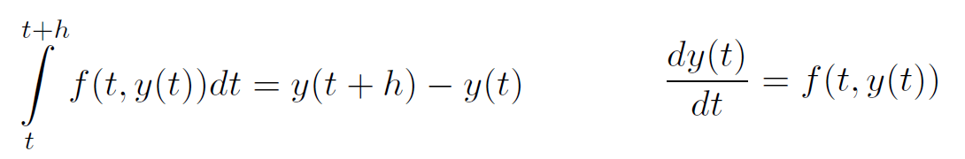
Development
Simpson’s Rule
Fundamental Theorem of Calculus

Slide 11
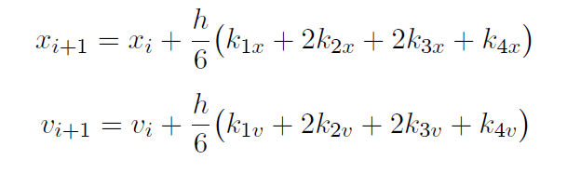
Development
Runge-Kutta (4)

Slide 12
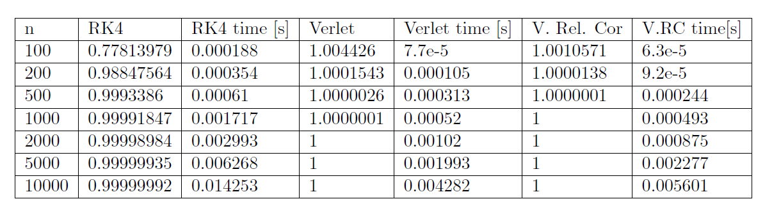
Testing the Algorithm

Slide 13
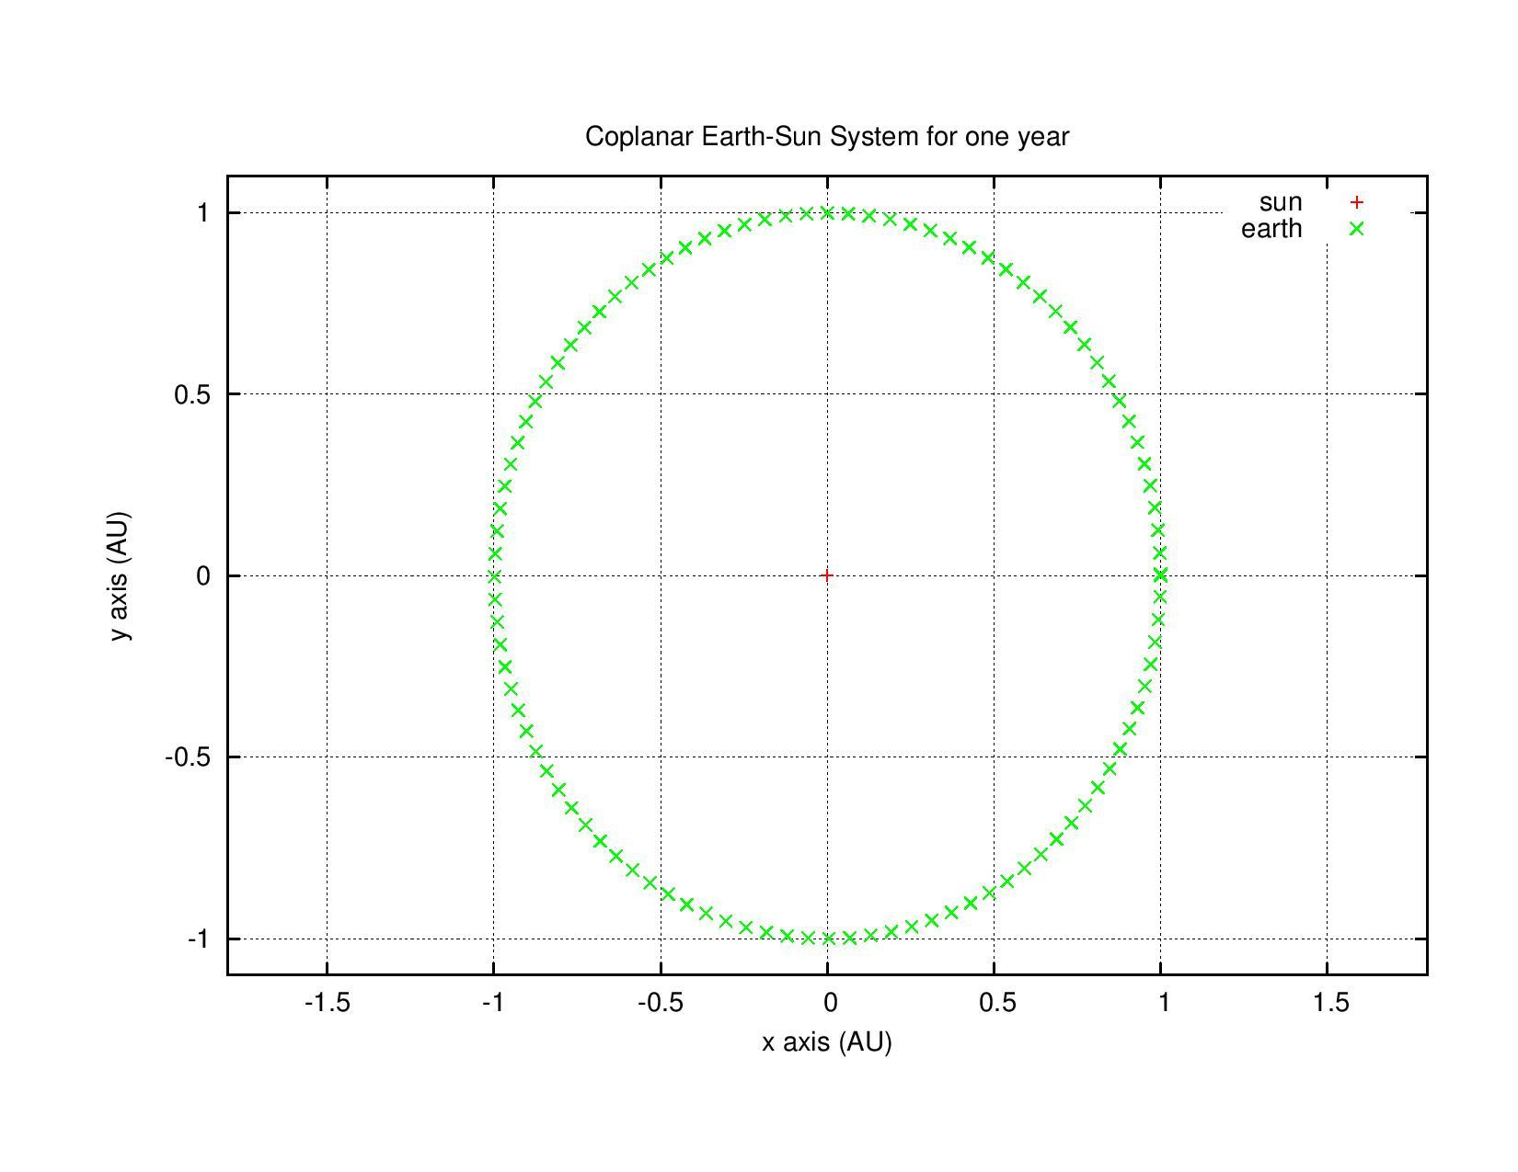

Slide 14
Results
Sun-Earth
Adjusting velocity
Sun-Earth-Jupiter
Adjusting mass
Solar System
Full system

Slide 15
Sun-Earth

Slide 17
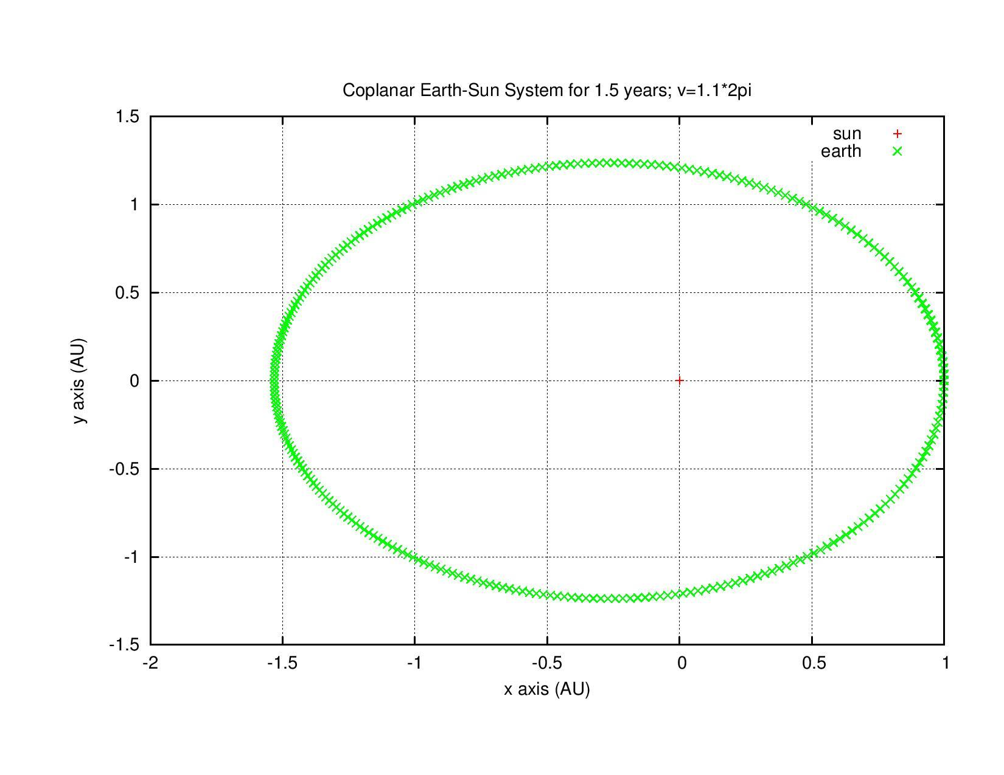
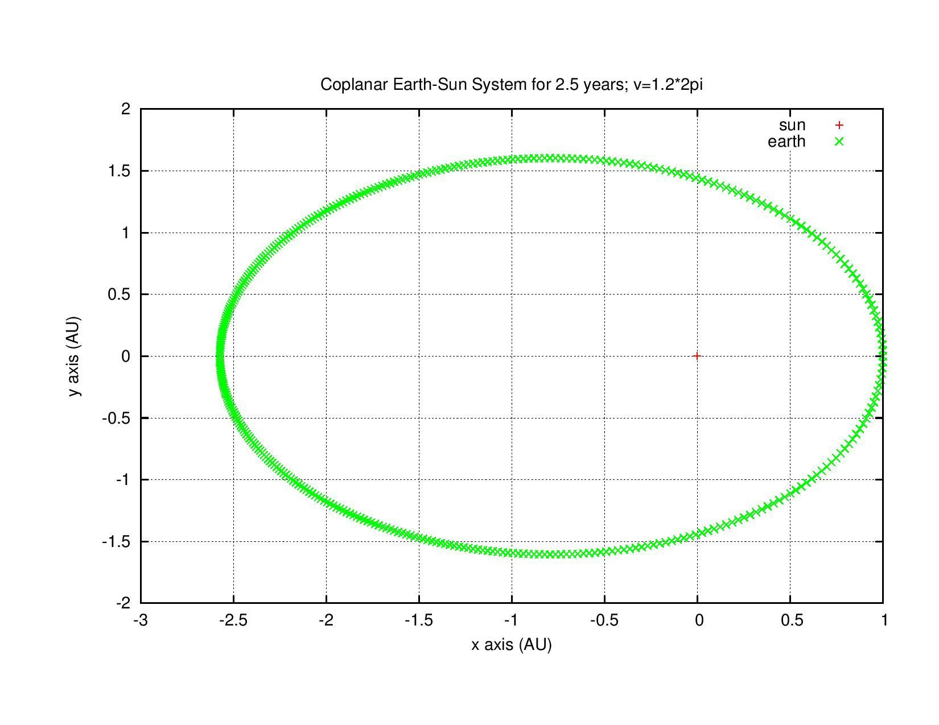
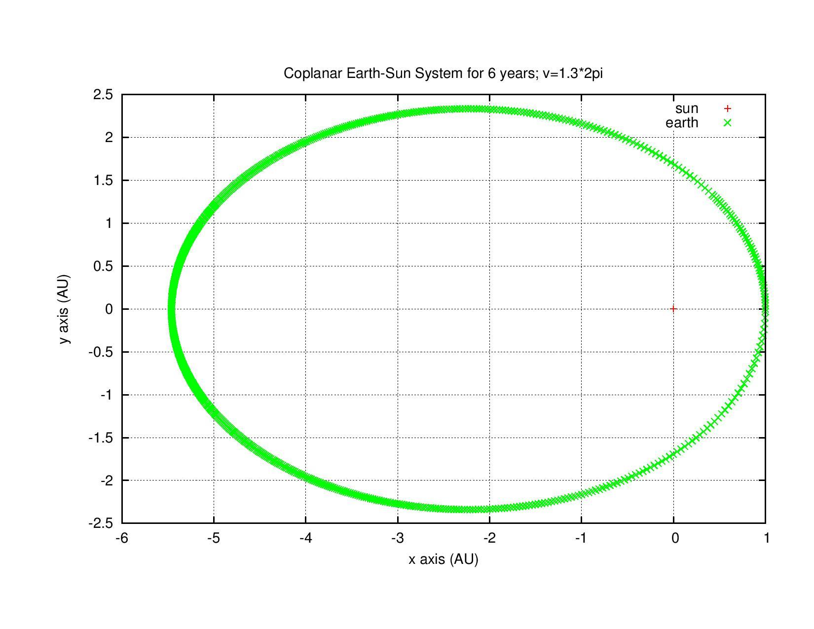
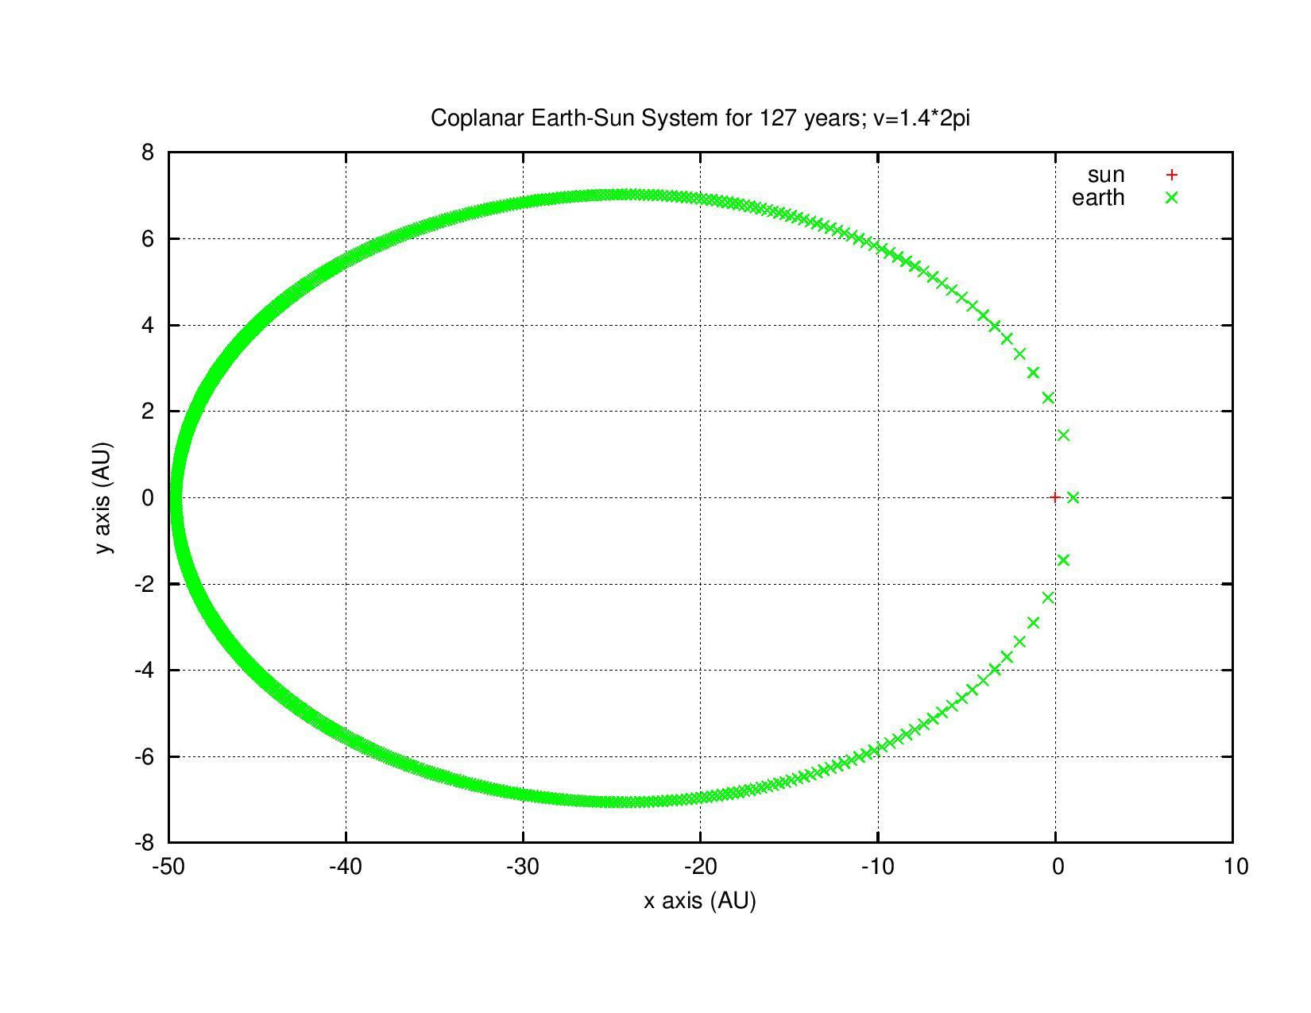

Slide 18
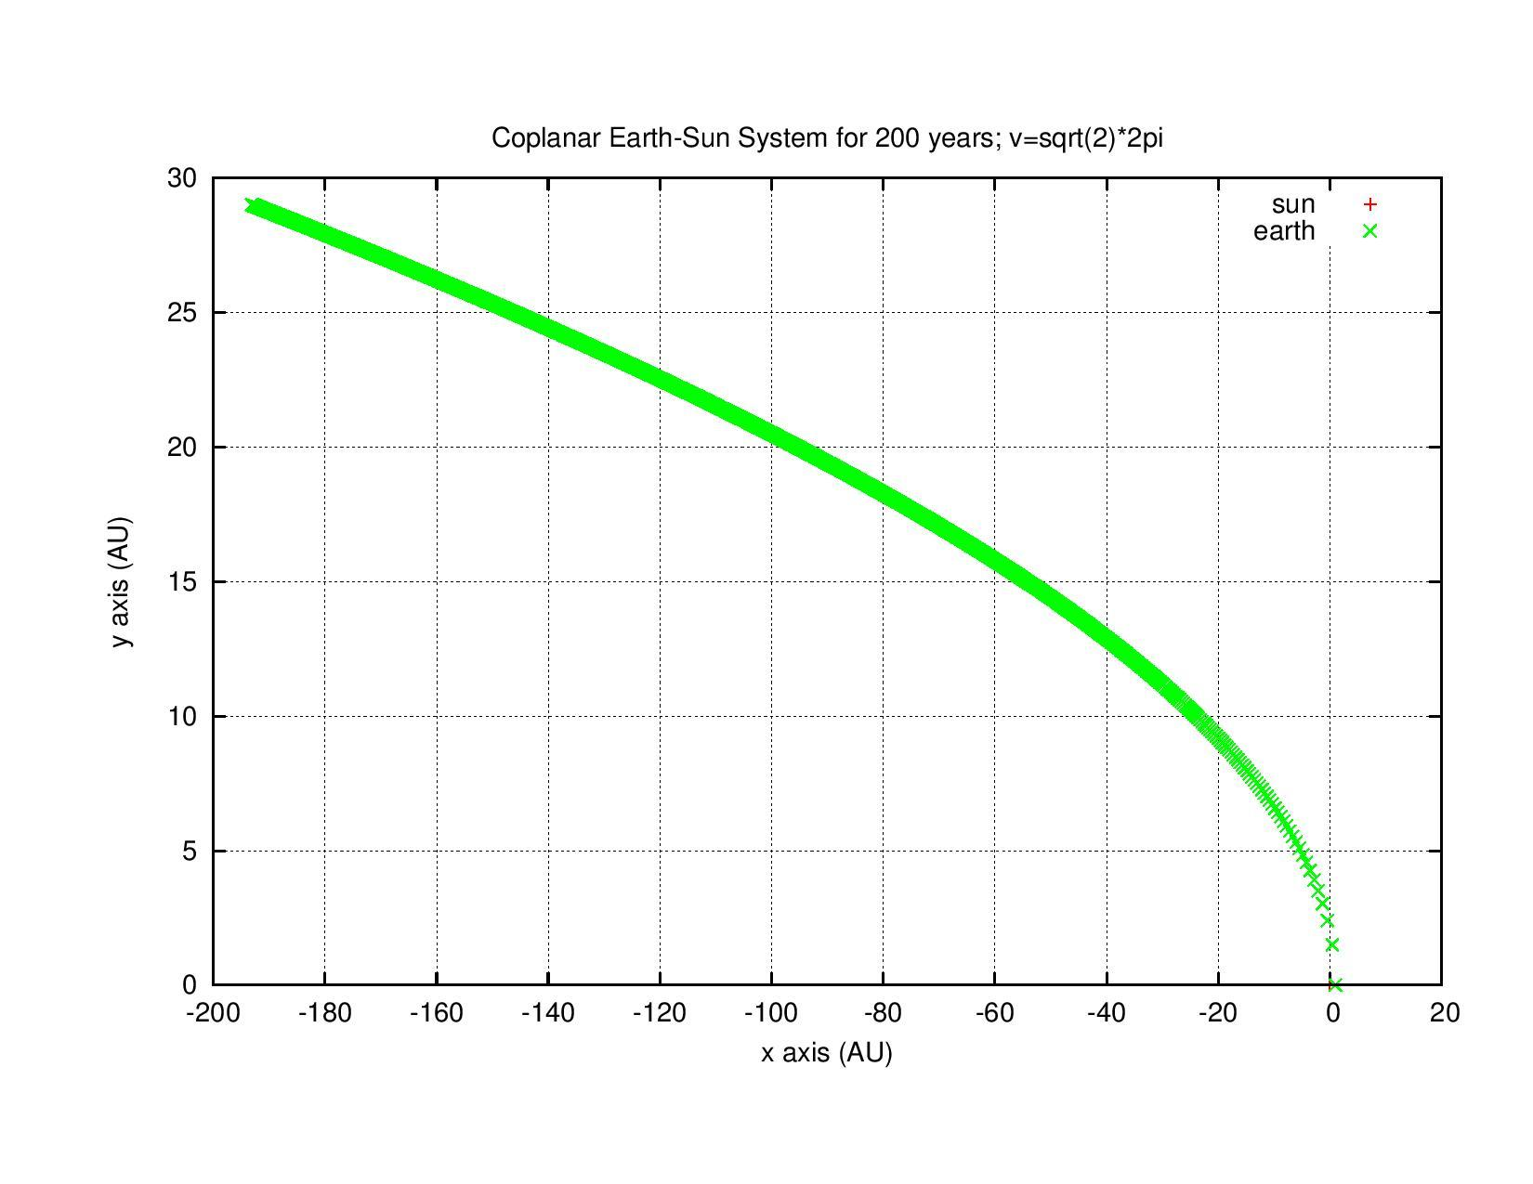

Slide 19
Sun-Earth-Jupiter

Slide 20
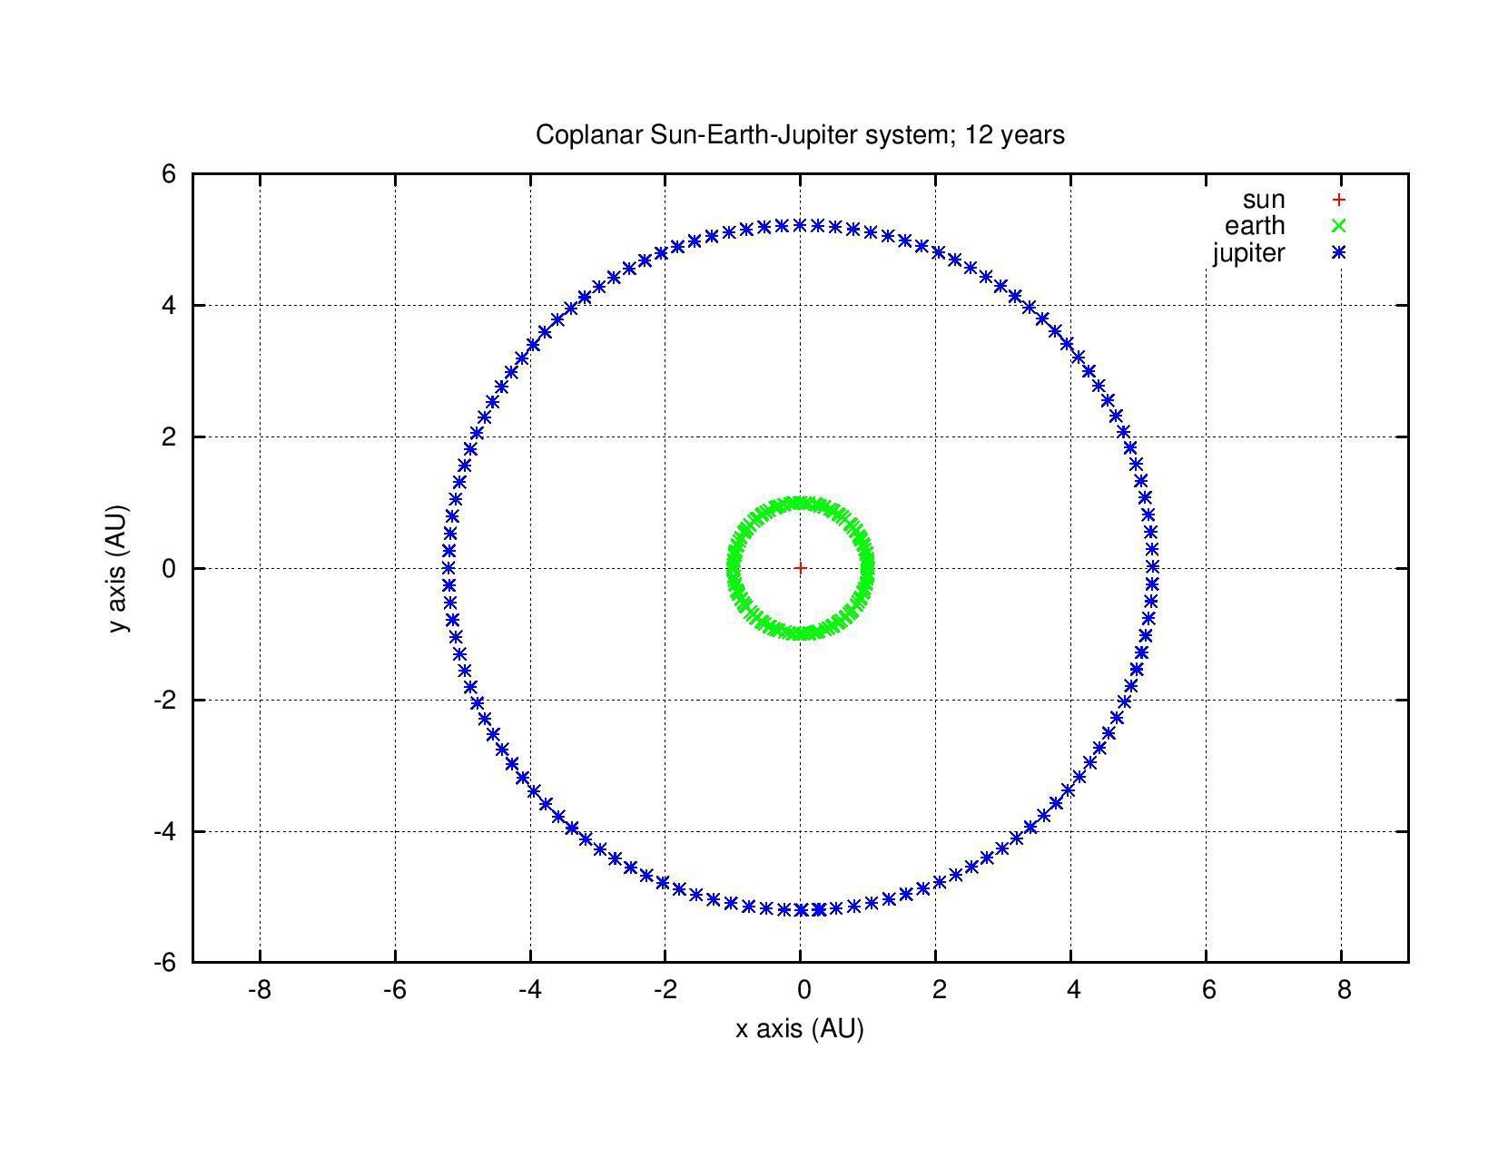
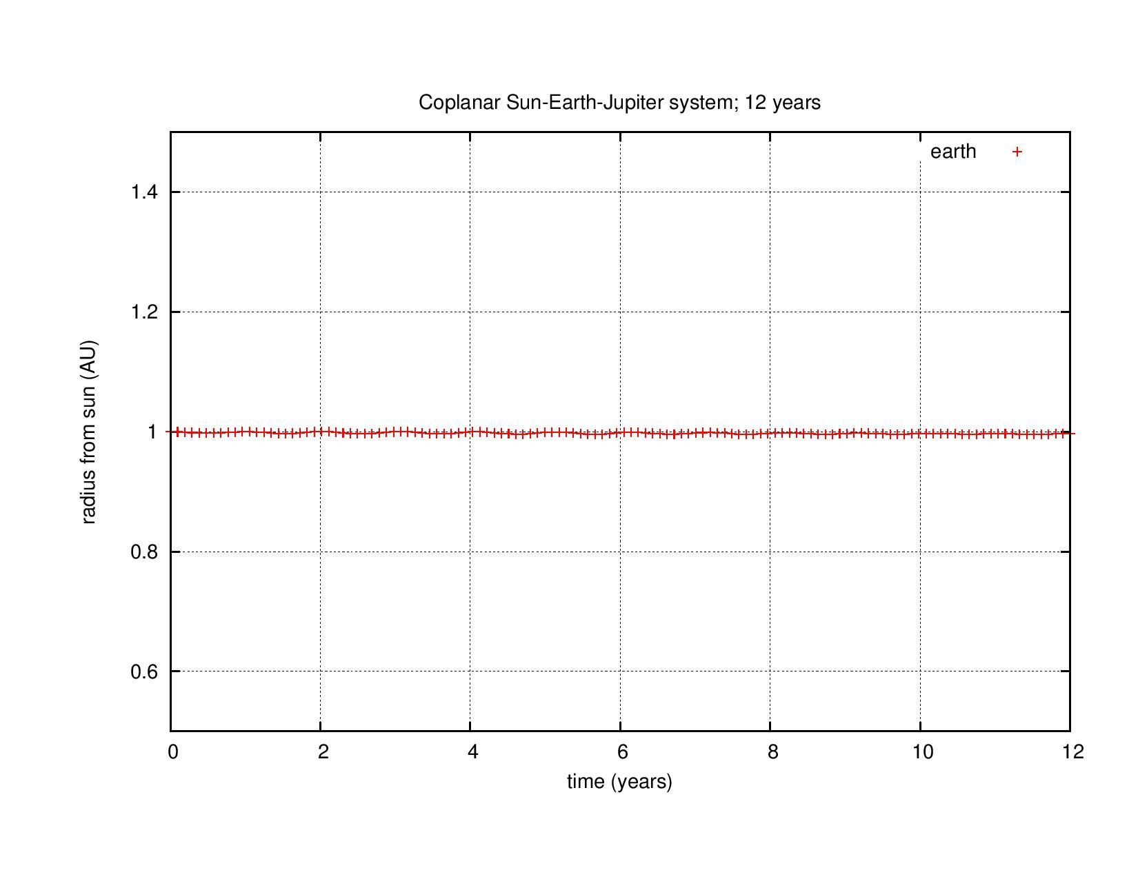

Slide 21
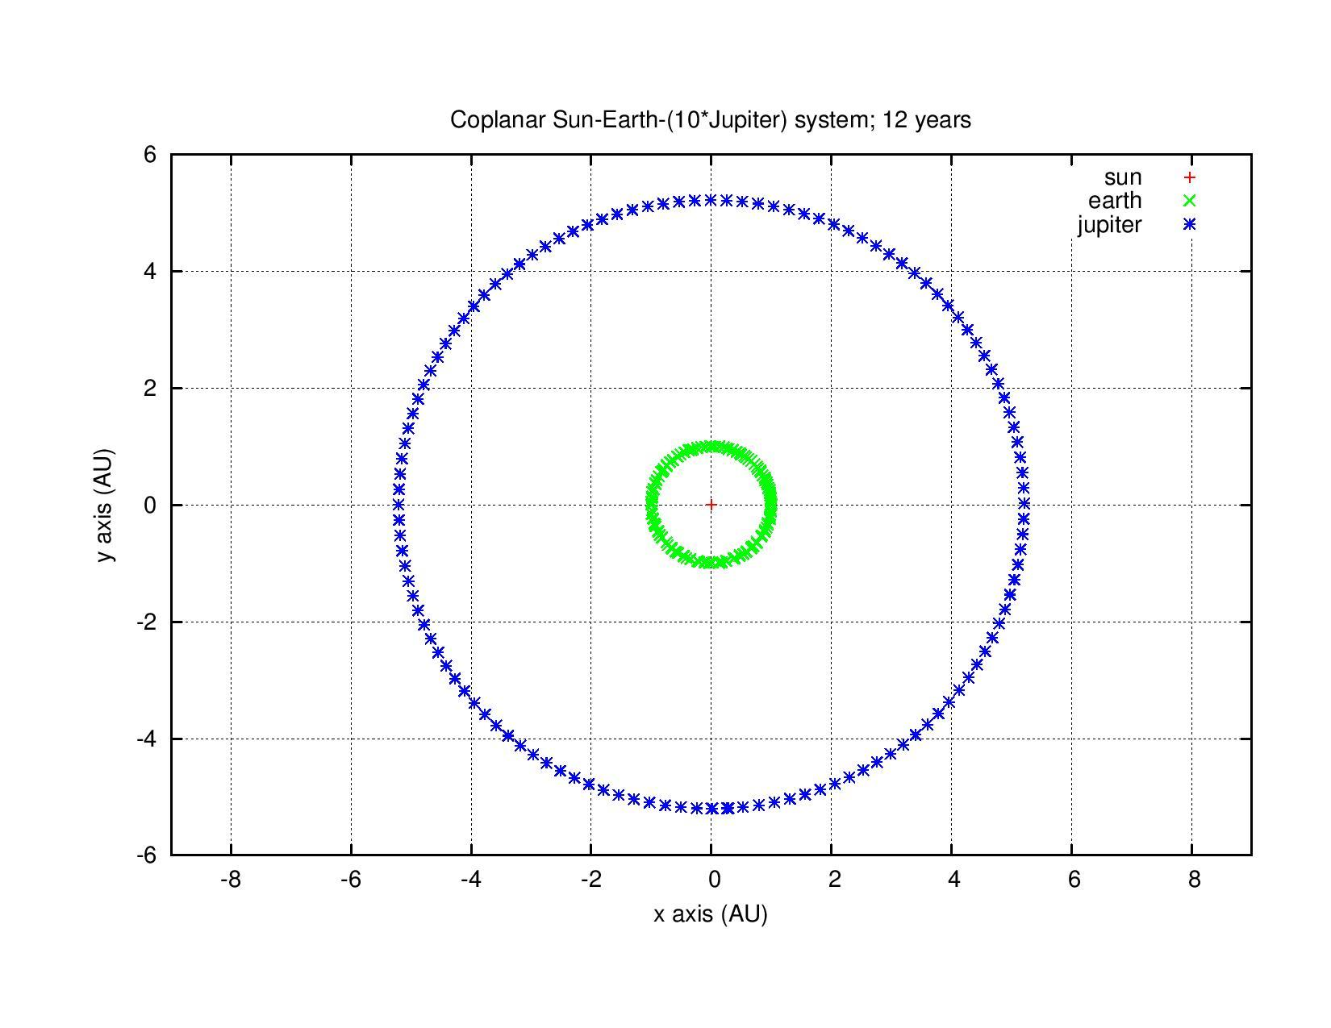
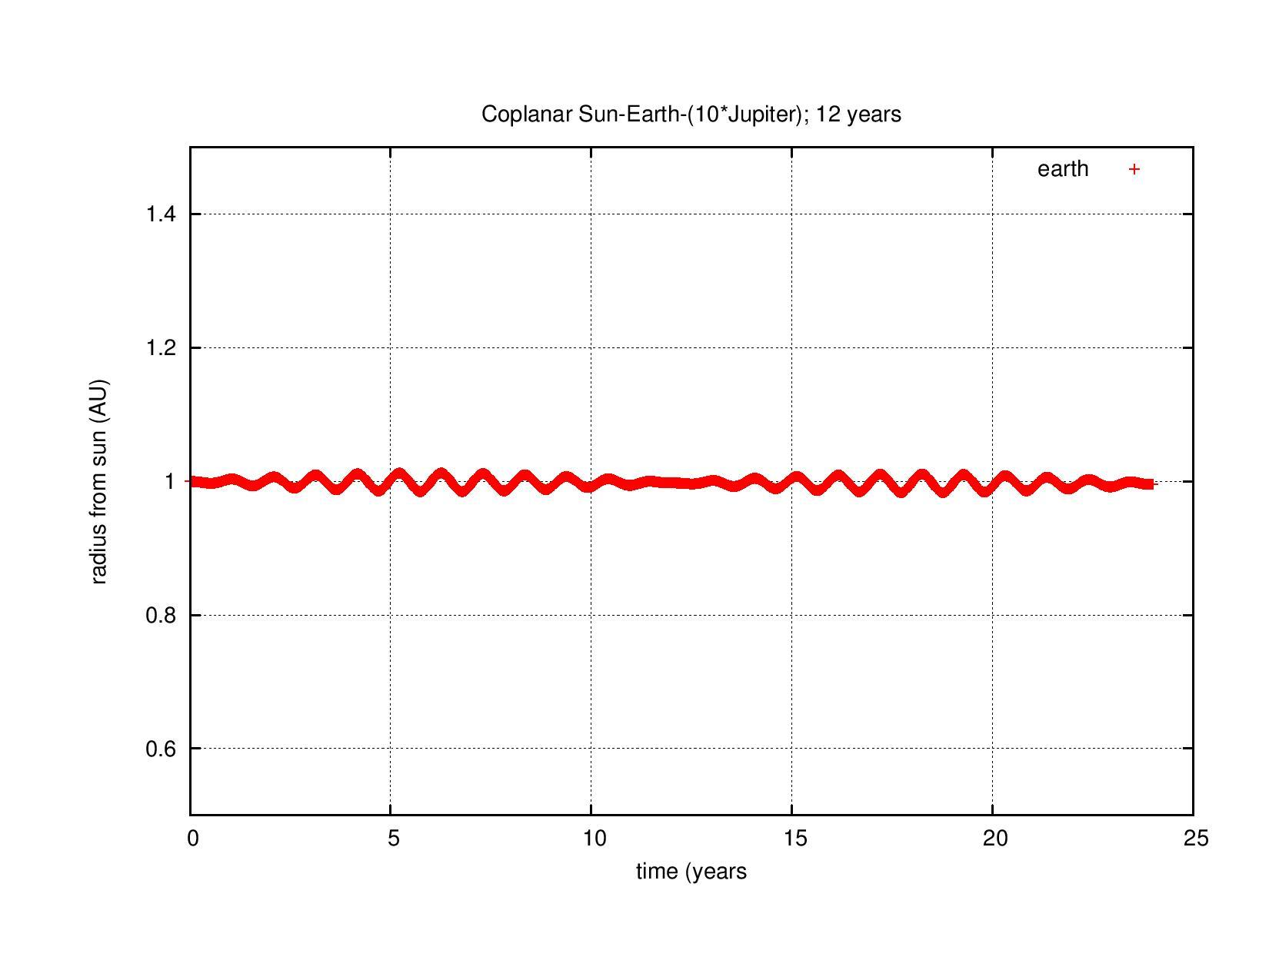

Slide 22
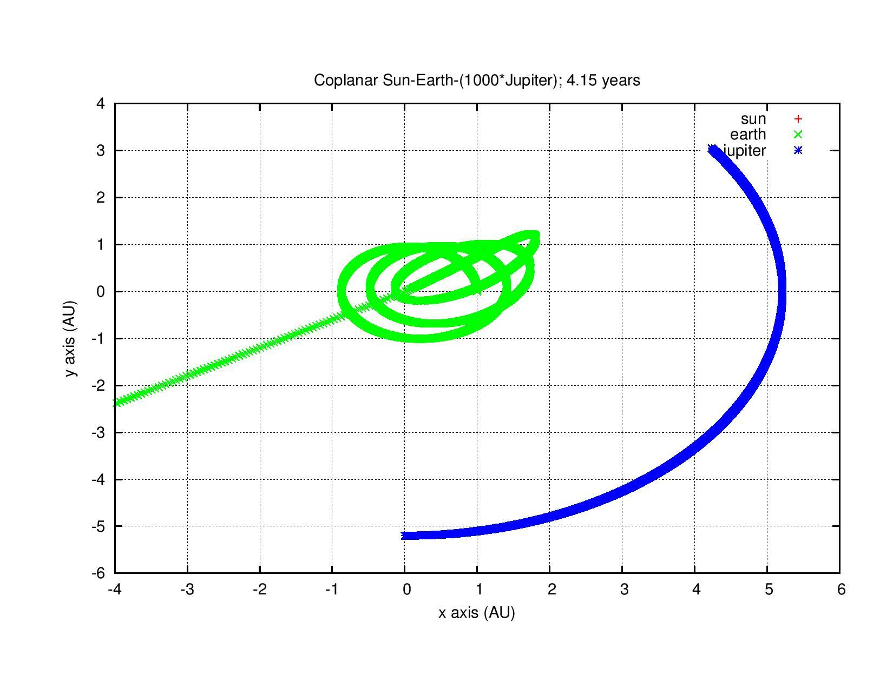
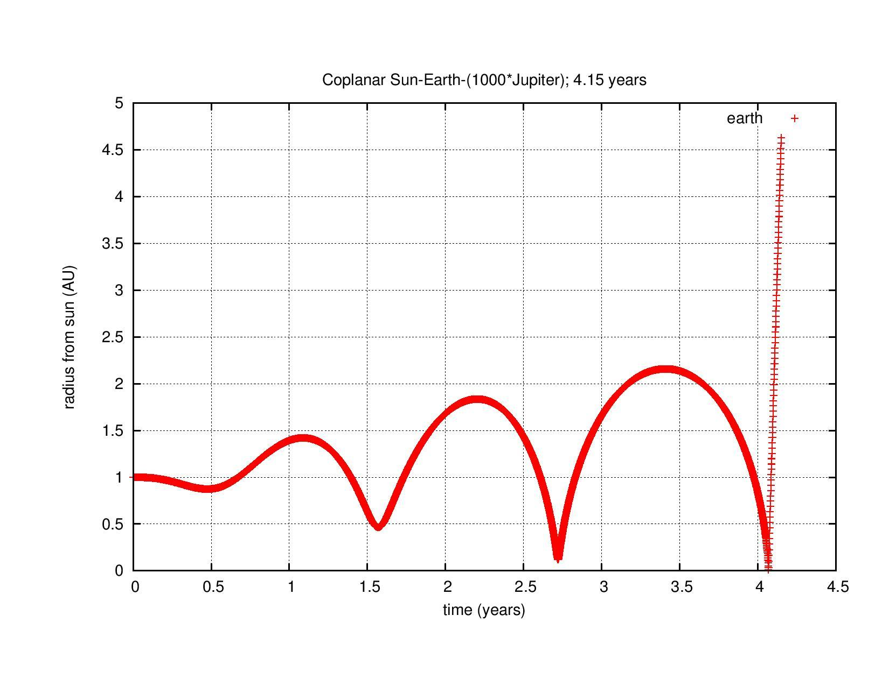

Slide 23
Solar System

Slide 24
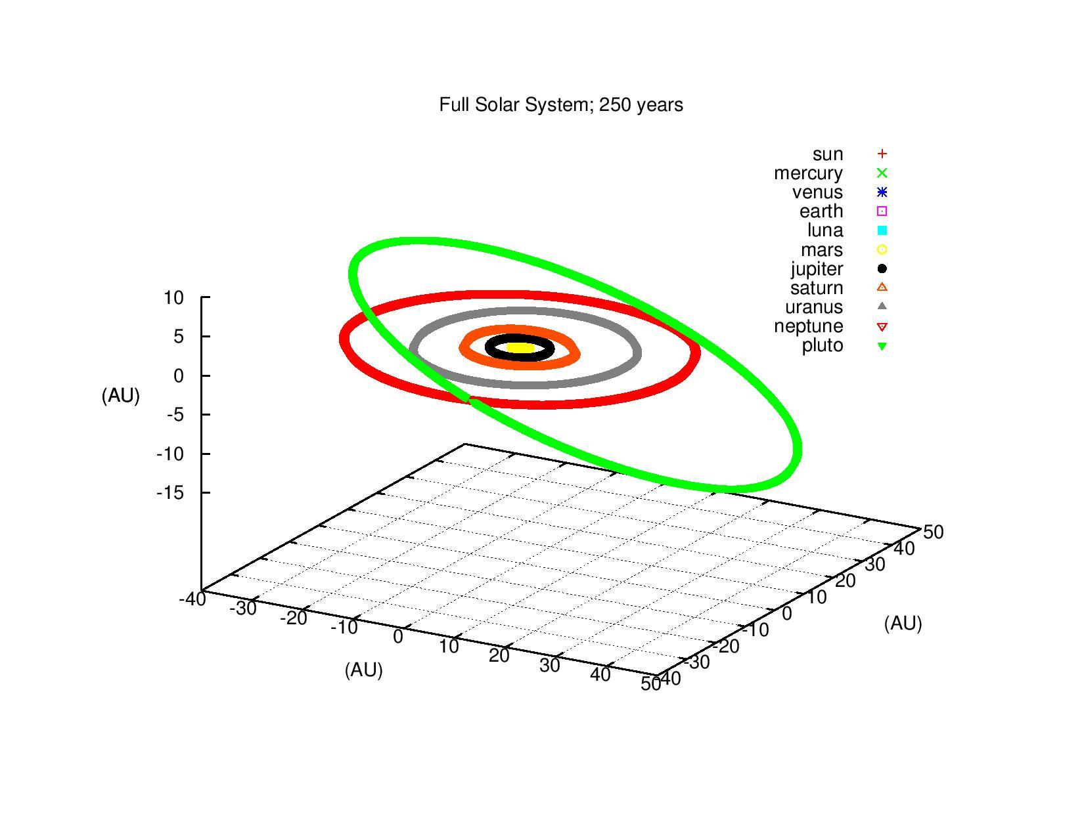
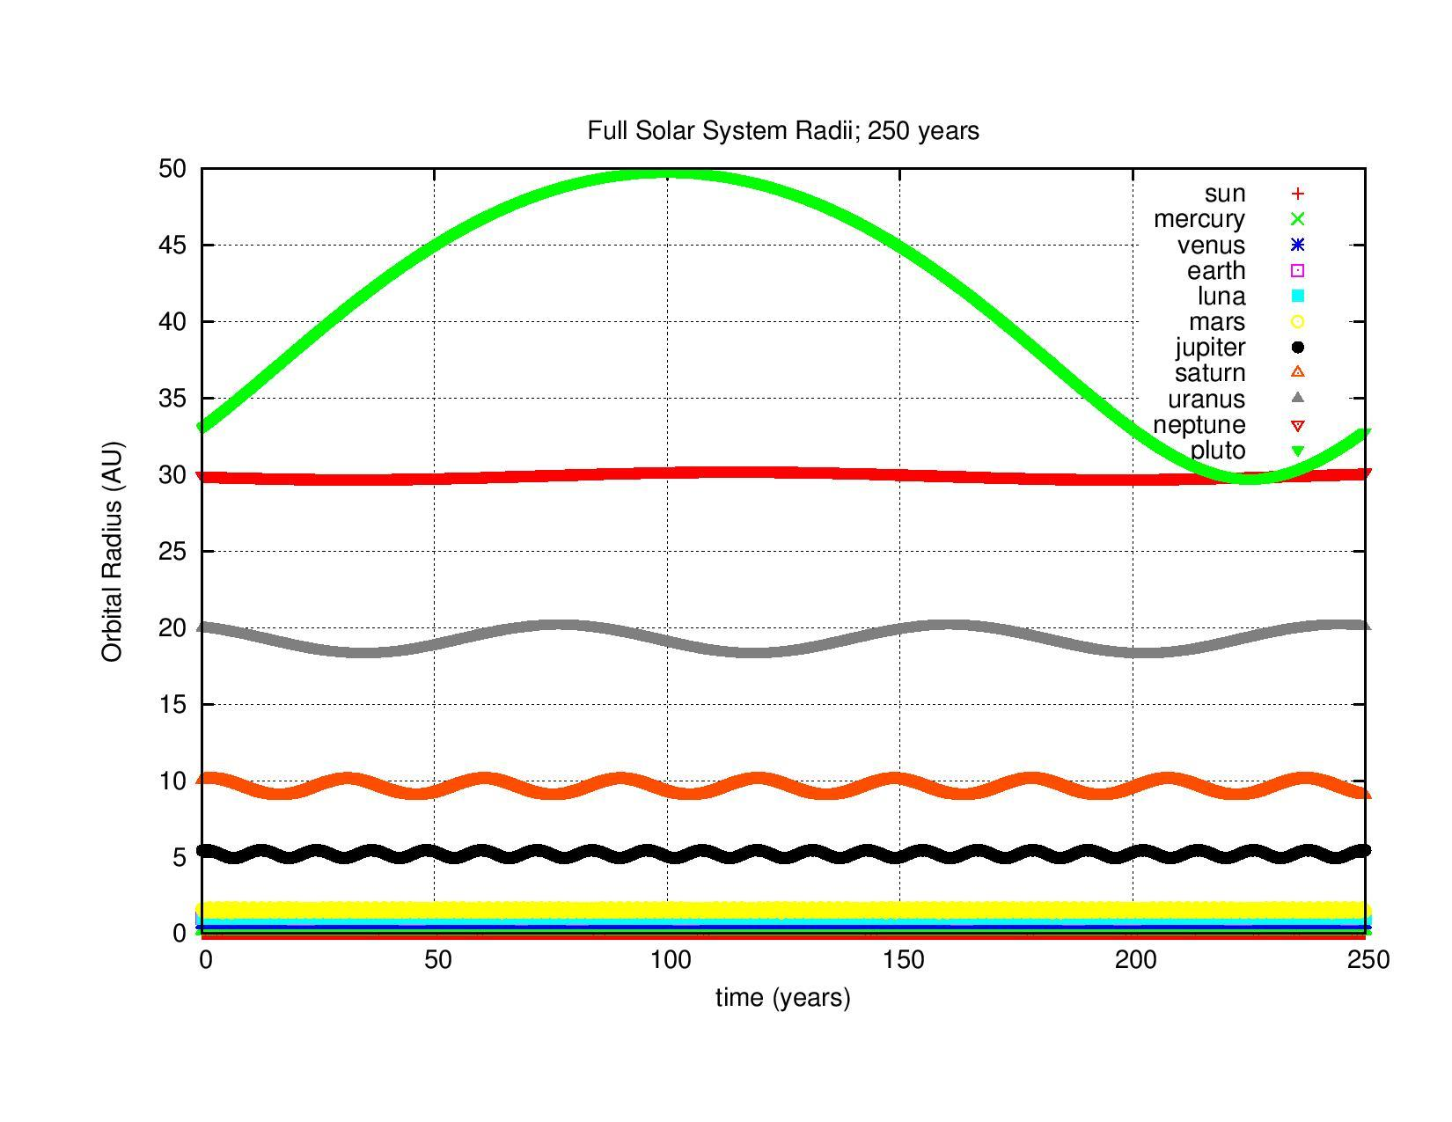

Slide 25
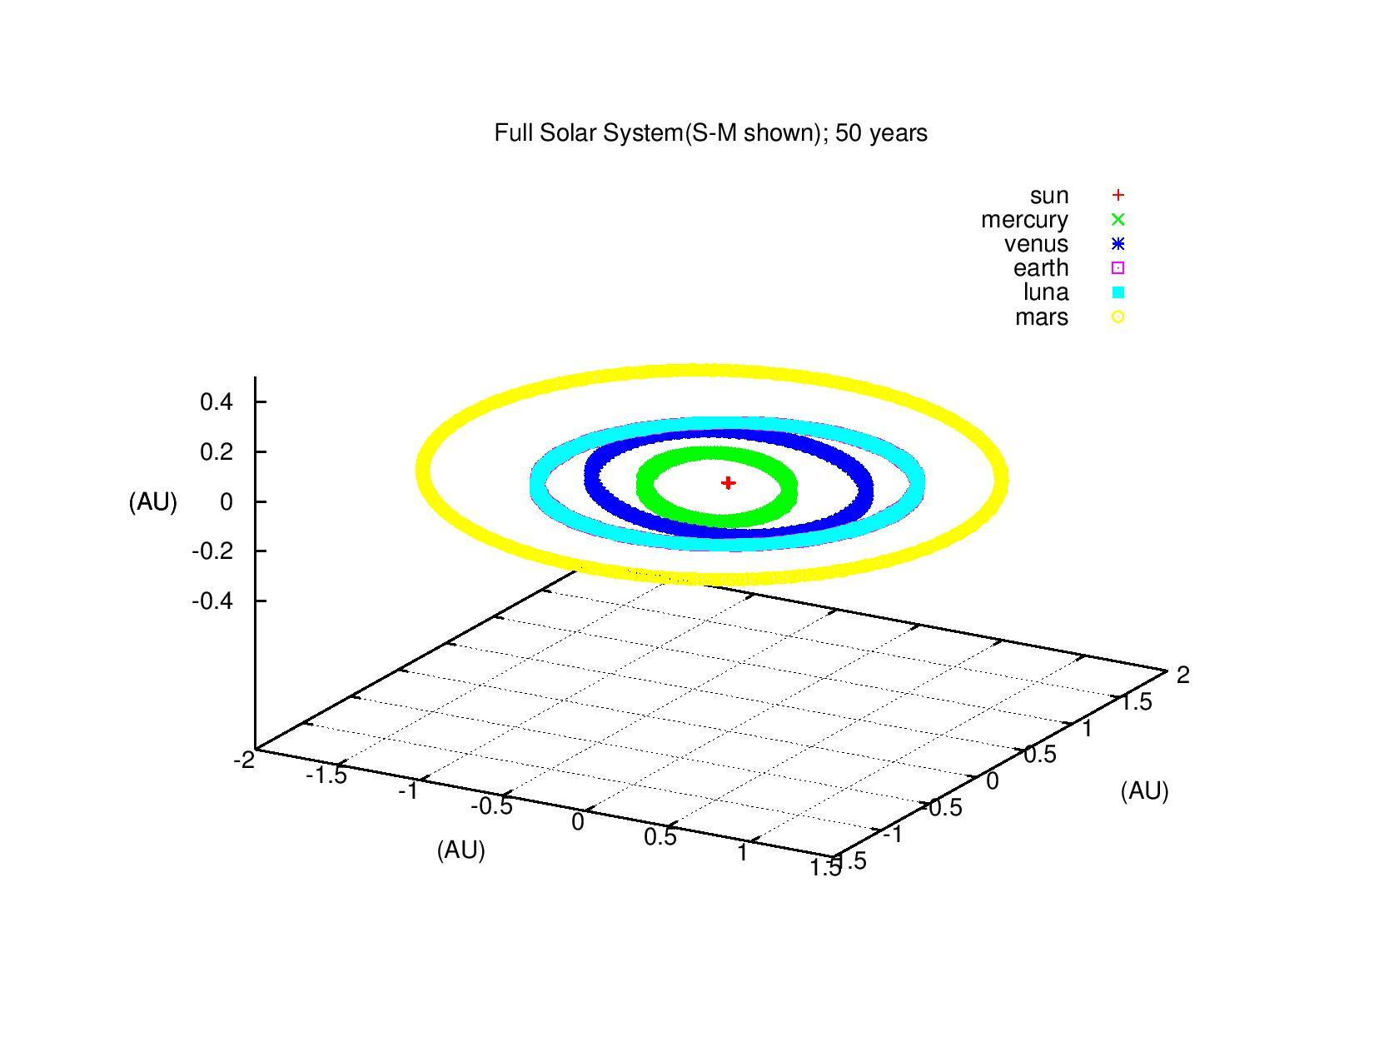
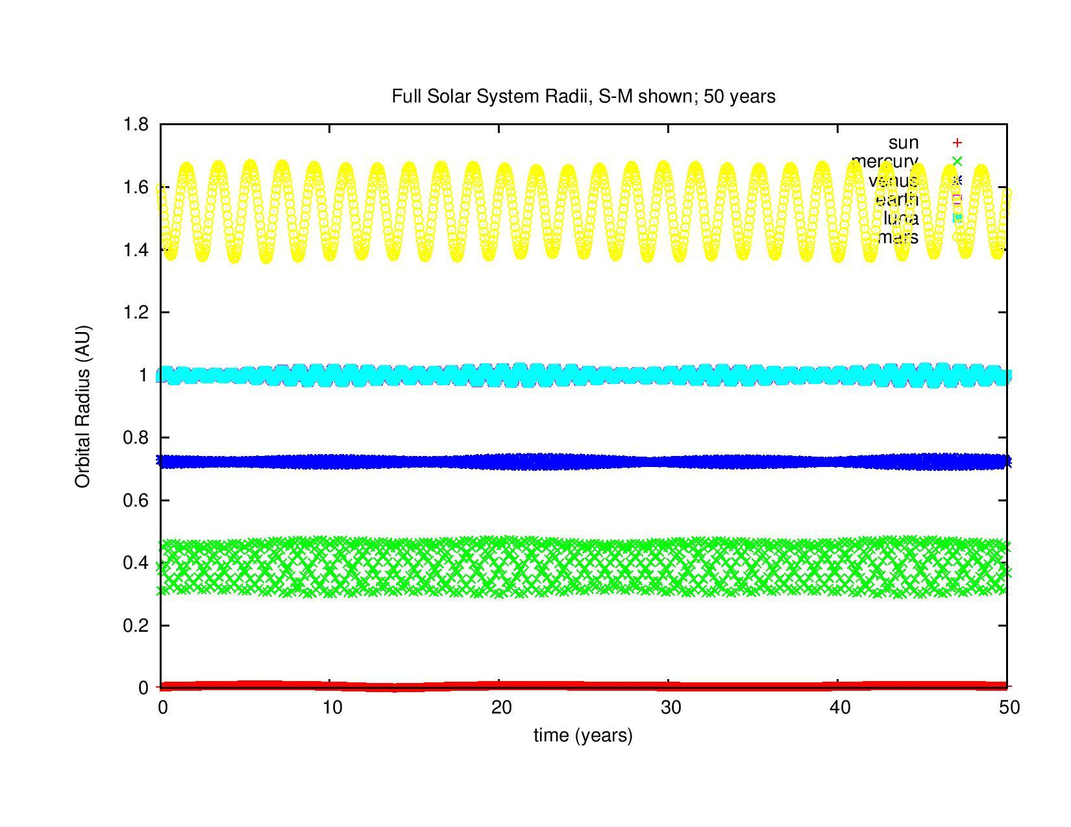

Slide 26
Eyes to the Future

Slide 27


Slide 28
Eyes to the Future
Calculate Period
Calculate Perihelion Precession
Reformat output
Dynamic step size
Collisions
Elastic
Inelastic

Slide 29
Thank you very much for listening

Slide 30
References
M. Hjorth-Jensen. Computational Physics, lecture notes spring 2016. Department of Physics, Michigan State University, 2016.
https://github.com/johnbower2012/CPMSU_work/tree/master/project3
Pictures:
Wikipedia & Freely distributed photographs

Slide 31
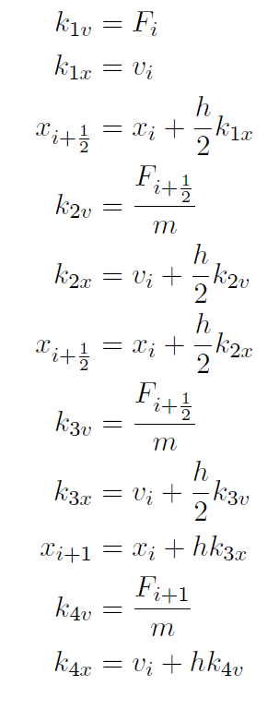
Development
Runge-Kutta(4)

Slide 32
